Slide 1
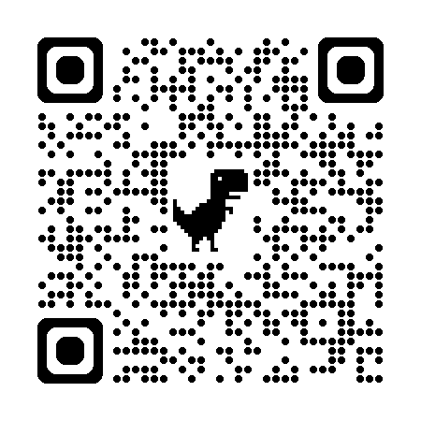


AI-DRIVEN DIABETES RISK PREDICTOR

Slide 2
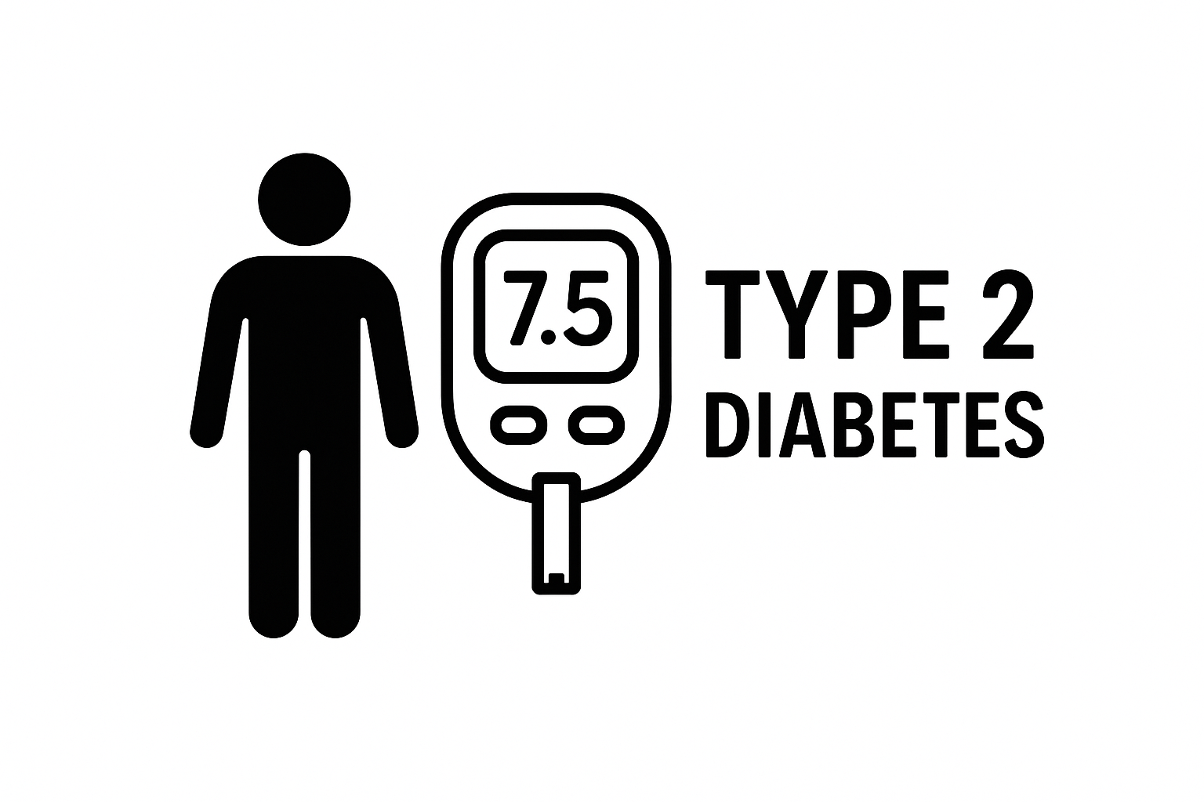
The Problem
24,600,000
Africans with Diabetes
369,100
Diabetic Ugandans
Because...
Low community awareness
Rising obesity
Late screening

Slide 3

Why It Matters
Prediabetes is reversible
with early detection.
Late treatment is 10x more expensive.
Diabetes clinics have data available.
Mobile phone penetration is high — big opportunity!

Slide 4


AI Solution
Mobile ML app predicting diabetes risk.
Metadata, lifestyle, vitals ,BG test(if available).
Early, accessible, affordable screening
Instant risk score + recommendations

Slide 5
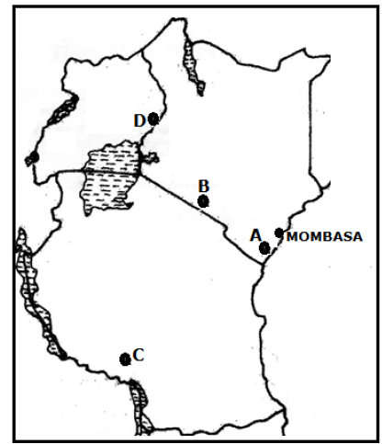

The ML Model
Locally trained for Uganda/EA.
Models: XGBoost, Random Forest
Dataset: metadata, Health history, diet, Blood glucose (if tested) .
1000; Low = 355, Inter = 426, High = 219

Slide 6
Models’ Metrics
Random Forest
XGBoost
 | Precision | Recall
Low | 94% | 97%
Inter | 90% | 95%
High | 98% | 86%
 | Model Accuracy | 94%
 | Precision | Recall
Low | 97% | 98%
Inter | 93% | 97%
High | 98% | 90%
 | Model Accuracy | 95%

Slide 7
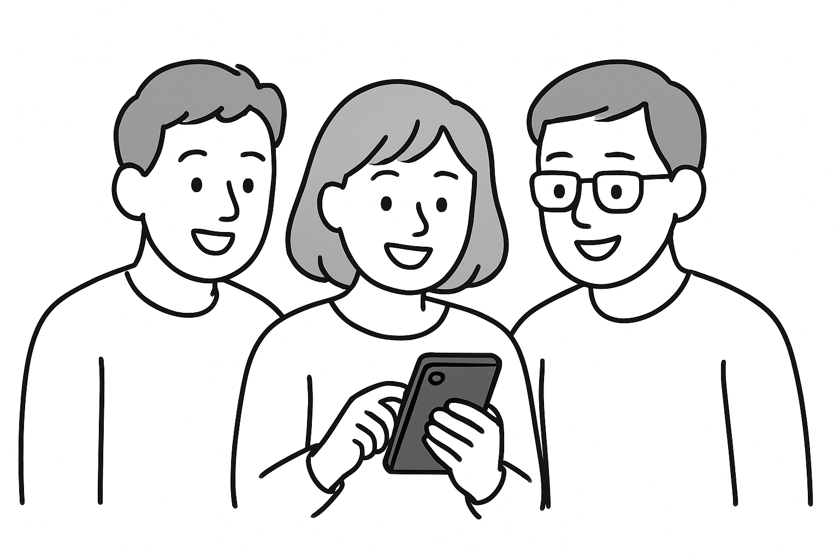
Key Features
Self-assessment (5 min).
Local language support.
Downloadable report.
Privacy-first design(no names).
Offline capability (soon).

Slide 8

User Personas
Community members: early guidance.
Community Health Workers: faster screening.
Clinics: triage support.
NGOs: risk mapping.

Slide 9

Impact Goals
Screen 300–500 people.
Identify 50–100 high-risk individuals.
Strengthen Community NCD awareness.
Create baseline dataset for ML improvement.

Slide 10




Pilot Plan (3 Months)
Deployment to 1 district/2 health centers (Weeks 3–8).
Evaluate, refine model, report (Weeks 9–12).
App Finalization (Weeks 1–2).

Slide 11


Funding Ask — $4,000
Field pilot ($1,500)
-2 Research assistants (RAs), Training of RAs, Transport, Airtime & data
App Refinement & Deploy ($2100)
- Allowances for Developer, Health advisor, & Deployment
Office expenses/petty cash ($700)

Slide 12

Sustainability & Scale
NGO partnerships.
Government integration.
Clinic subscription model.
Insurance and employer wellness programs.
Long-term: multi-NCD Prediction platform

Slide 13

Why Us
Strong ML expertise
Deep understanding of local health context
Pilot-ready Product
High-impact results for a low-budget pilot

Slide 14
The Team
Hellen Nakabuye (Msc. Bioinformatics, Bsc. Bioinformatics)– Team Lead
Richard Ssekitto (Bsc. Nursing, Pdip. Health Systems Mgt)– HeathTech Advisor
Paul Mbavu (Msc. Bioinformatics, Bsc. Software Engineering) – Software Advisor

